Slide 1
Leadership for Organizing and Action
Strengthening Coalition Engagement
Virginia Falls Coalition Meeting
November 13, 2019

Slide 2
Session Goals
Define new leadership concepts for coalition- building
Identify coalition or team needs
Learn new organizing tools
Identify additional resources for coalition and teams

Slide 3
Suggestions for Learning…
Avoid distractions (please silence your ring tone)
Use resources during and after session
Step-up/Step back
Try on the skill
Lean from each other

Slide 4
Attribution
These sessions include content that was originally adapted from the works of Marshall Ganz of Harvard University and used in Leadership & Organization in Action Distance Learning Course offered by QIN-NCC in 2015. This content has evolved over the course of many iterations by Liz Pallatto, Joy Cushman, Kate B. Hilton, Chris Lawrence-Pietroni, Nisreen Haj Ahmad, Hope Wood, New Organizing Institute staff, and many others.

Slide 5
Your Role as a Coalition Leader
Convener-Building trust through narrative, intentional relationship, and active meeting stewardship
Leadership Developer-selecting and developing leaders equipped to empower local solutions to promote safe, coordinated care
Community Organizer-regional approach to healthcare improvement through active engagement of providers/stakeholders across the entire continuum of care
Notes:
You are all strong leaders with very different leadership styles that have been developed and perfected over the years. Coalition leadership requires a different set of skills. We will require these skills as we continue to expand and develop our community.

Slide 6
Six Essential Skills for Coalition Leaders
Inspiring a motivating vision
Building relationships
Engaging networks
Structuring teams
Strategizing collectively
Learning in action

Slide 7
What is Leadership?
“Leadership is accepting responsibility for enabling others to achieve shared purpose in the face of uncertainty.”
A practice, not a position
Authority is earned, not bestowed
Focus is on developing others, not just yourself

Slide 8
What is Organizing?
CHANGE
Using the power to address the challenge the constituency is called to face
POWER
Building a community around that leadership to create power
PEOPLE
Recruiting and developing leadership
Notes:
As a coalition, we’ve taken these steps as we continue to move forward...
When you combine the power of the right people coming together to address the challenge, you have the ingredients you need for success.

Slide 9
What is Power?
Notes:
We are stronger together! As individual “players” in the market you may not have the “power” to make an impact, but when everyone comes together, the ability to impact change increases exponentially!

Slide 10
Mobilizing vs. Organizing
Mobilizing Organizing

Slide 11
Common Leadership Models
Notes:
Traditional org chart hierarchy that we probably all function within the confines of.

Slide 12
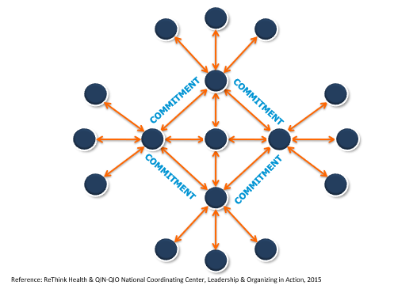
Interdependent Leadership

Slide 13
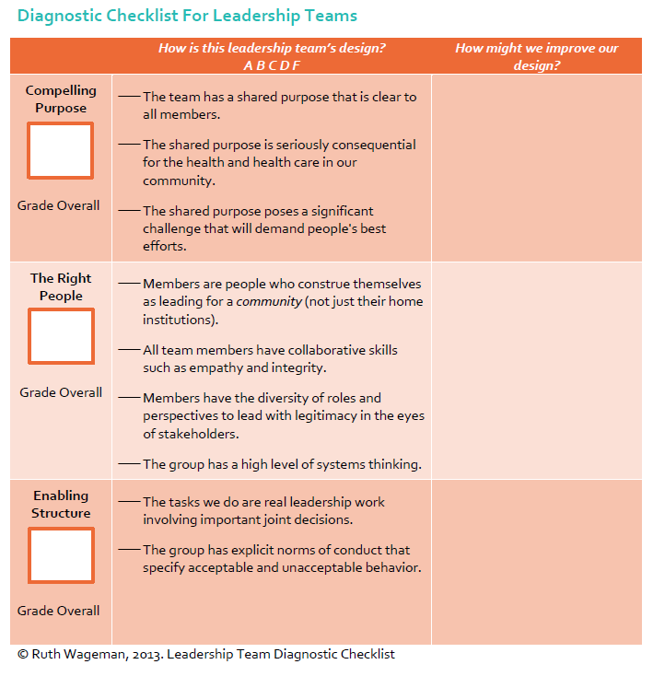
Diagnostic Checklist for Leadership Teams

Slide 14
A Compelling Purpose: Using the Organizing Sentence
Notes:
One way to clarify or define a group’s vision is through the development of an organizing sentence. This helps everyone involved to be clear about who, what, how, why and when. In C3, very often, a community coalition has a charter that includes these details but this can condense everything a little more. Let’s walk through the components of an organizing sentence.

Slide 15
I’m organizing….WHO?
Patients and Families
Physicians
Hospitals
Practice managers
Home health agencies
Discharge planners
Social workers
Pharmacists
Diabetes education centers
Community organizations
Faith-based organizations
Long-term services and support organizations
Advocacy organizations
Associations
Notes:
Most of us are pretty clear about who we are working with or tasked to work with… With community coalitions or groups, it

Slide 16
To do….WHAT?
Measurable Aim(s)
To engage 300 dual-eligible patients in practicing ABCS
To recruit 500 dual-eligible beneficiaries for DSME classes
To complete a pilot (PDSA) that engages 250 patients
To engage 5 early adopters in each (of 10) hospitals to recruit 20 physicians from other departments (1000 total) to participate in a learning network
To launch a nursing home collaborative with 75% of the nursing homes in my state (and a leadership team of 6-8 people) and meet at least 5 times
To develop 5 community coalitions (with 4-6 leadership team members and 40+ stakeholders), each of which implements two interventions

Slide 17
Motivation Vision – (Why?)
What is the urgent challenge?
What is the intolerable condition that you want to end or to avoid?
Why is the action urgent now? What is at stake?
What is the motivating vision?
What does achieving success look like?
What is a plausible path forward?
What could happen if you acted now?
What is the first step we can take?
Notes:
WHY is your group trying to accomplish those goals? These questions really help a group get to the heart of the matter. A narrative engaging partners can shed a light on the WHYs but some great conversations occur with this section. Once you have the WHYs clear – everyone is clear….
The last part is the time.

Slide 18
Organizing Sentence
Notes:
We want to encourage you all to create a tight organizing sentence for your task/team by our next meeting.

Slide 19
Example
We, the ABC coalition of 40 local stakeholders, are organizing with local residents, healthcare providers, public health organizations and community-based organizations of the city’s west end to improve food accessibility to residents with chronic diseases by building and strengthening local collaborations through a community participatory approach and by increasing awareness of social determinants in order to save lives, reduce hard and increase the capacity of the community to take action to advance the health of its residents.

Slide 20
Organizing Sentence
Notes:
We want to encourage you all to create a tight organizing sentence for your task/team by our next meeting.

Slide 21
The Right People Using the “Mapping Actors” Tool
Notes:
Engaging Networks
One challenge facing coalitions or groups is engaging a certain threshold of people to generate collective impact. At the same time, people come with different amounts of power and resources. This imbalance of power can lead to conflict, competition, opposition – and, worse, a lack of commitment to work together. A second challenge is a conventional mental model in which stakeholders “solve a problem” by “bringing in” outside resources. This approach is unsustainable once outside interests change and resources disappear. A third challenge is leaders who could be lacking collaboration skills.
To overcome these challenges, it is important for we to coproduce strategies with stakeholders that:
• Recognize people as assets;
• Build on people’s existing skills and resources;
• Build strong and supportive social networks; and
• Promote trust by breaking down the divisions between service providers and service users.
To do so, QIOs can map actors, assets, and power and develop a network-building strategy that enables them to recruit collaborative leaders, align resources, and exercise influence.

Slide 22
Map of Actors
Constituents are the people at the center of our work, the people whom we bring together.
Leadership. Our leadership is derived from members of our constituencies.
Supporters. Supporters are people whose interests are not obviously affected by our work but who may find it in their interest to support it.
Competition. These are individuals and organizations with whom we share interests, but have different ideas about how to achieve our goals
Opposition. In pursuing our goals we may find ourselves in conflict with the values and interests of other individuals or organizations
Notes:
Whenever possible map by name
Actors & assets are not static. You and your team can start mapping at any time, but it is important to come back together – for example, after you have engaged in a round of one-to-one meetings – to re-map your actors. Early one-to-one meetings will offer clues about who may be good prospects for leadership roles; or who might be members of more than one group – because, for example, it is possible for opposition to come from within our constituency. And it’s also important to keep track of who else is out there that you haven’t yet mapped.

Slide 23
Dynamic, not Static: Noting the shifts
Your Map will shift as you learn more...
Your Aim
Constraints
Actors and Resources
Opportunities
“In organizing, there are no permanent friends and no permanent enemies….”
Reference: ReThink Health & QIN-QIO National Coordinating Center, Leadership & Organizing in Action, 2015
Notes:
This mapping process is something that needs to be revisited at several key points along the way of your organizing project. After you have engaged in an initial round of 1:1 meetings, you may note some shifts in your map—re-mapping your actors is an important team activity.

Slide 24
Enabling Structure Building a Snowflake

Slide 25
Why do we build a snowflake?
To distribute the work among different groups
To recruit and develop leadership
To enable opportunities for people/organizations to creatively combine their resources.
To build relationships…

Slide 26
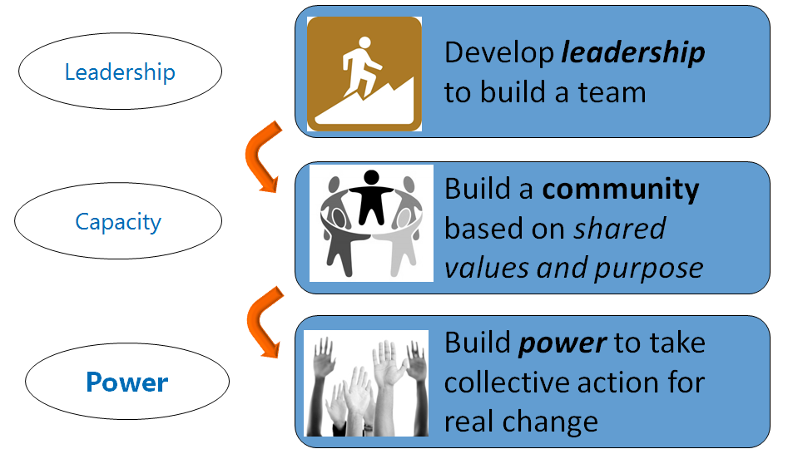
Why do we build Relationships?
Notes:
Relationships enable you to build capacity:
First by distributing the work through the recruitment and development of a leadership team Then by building a community that shares your values and is willing to act collectively to help achieve your shared purpose
And then by creating the POWER you need to make the change that you want.

Slide 27
Relationships are...
Intentional and Public
Grounded in Shared Values
Mutual Exchange of Skills and Resources
Result in Growth and Learning
Reference: ReThink Health & QIN-QIO National Coordinating Center, Leadership & Organizing in Action, 2015
Notes:
A relationship is intentional and are cultivated in a public setting. They involve on-going attention and work.
As stated before, relationships emerge from a sense of shared values. We identify the values that we share by learning each other’s stories. The key to eliciting values is asking “why” questions – about what motivates us. That means that we have to get to know one another – to understand who another person is, and let them see who we are. Not just our quality improvement agenda, but why it counts and why it matters.

Slide 28
Relationships are NOT...
Casual
Private or Intimate
One-sided
Purely Transactional
Reference: ReThink Health & QIN-QIO National Coordinating Center, Leadership & Organizing in Action, 2015
Notes:
When we are talking about relationships in the organizing context, we are careful to distinguish that we are not talking about the personal, private relationships that are our everyday lives. Nor are we encouraging you to form relationships that are merely transactional or one-sided.

Slide 29
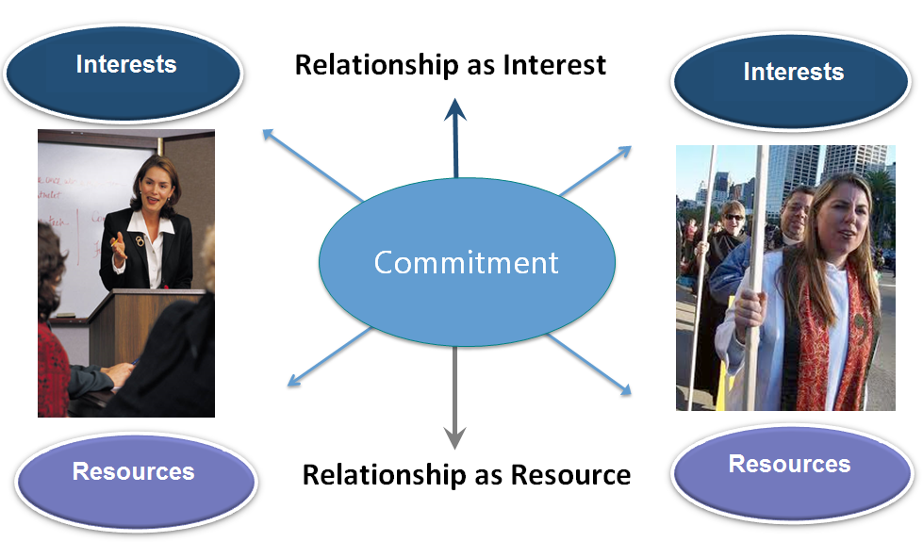
Why do we build Relationships?
To Generate Resources
Notes:
Commitment—We put this front and center. It is a resources that keeps on growing—as the commitment grows—the relationship itself becomes an interest and resource. As the relationship grows so does our capacity—as we agree to pool our resources.
The relationship is always a work in progress and needs to be maintained but if it is established based upon a firm foundation of interests, values and commitments, it can be a resource that grows with time.
An example of this is the relationship and commitment that Betsy Archer and I share. Through our work, we have identified common goals such as HAI reduction and creating a safe environment for patients. We have very similar values and interests both professionally and personally. My clinical background is a resource and Betsy's ability to convene hospital leaders is a resource for me. Our relationship has now elevated to the point that the relationship itself is the resource.

Slide 30
From Compliance
States a minimum performance standard that everyone must achieve
Uses hierarchy, systems and standard procedures for coordination and control
Threat of penalties/sanctions/shame creates momentum for delivery
Based on organizational accountability “If I don't deliver this, I fail to meet my performance objectives”
To Commitment
States a collective goal that everyone can aspire to
Based on shared goals, values and sense of purpose
Commitment to a common purpose creates energy for delivery
Based on relational commitment “If I don’t deliver this, I let YOU the group or community and its purpose down
Reference: ReThink Health & QIN-QIO National Coordinating Center, Leadership & Organizing in Action, 2015
Notes:
As a reminder, we are talking about commitment – not compliance.
Goal we aspire to “the dream” vs. minimum standards (stretch vs. contract)
Common purpose not regulatory requirement
Relational commitment not organizational accountability

Slide 31
The One-to-One Meeting
1. Selection & Attention
Whom shall I ask?
Use your actor’s map to think strategically about whom you want to build relationships with
Be clear about what you are looking for
Explain how you got the person’s name and common connections
Reference: ReThink Health & QIN-QIO National Coordinating Center, Leadership & Organizing in Action, 2015
Notes:
The first step is the step that you conduct long before the meeting begins. It is the step, you start thinking about your actors map. You want to have as many productive meetings as possible. To do this, you need to be strategic in who you select to meet with. So, assuming that you have thought carefully about who you want to meet with, the next step is to state up front what you want to discuss and also share how you got this person’s name or any common connections you might have.

Slide 32
How do we build Relationships?
Selection: Strong vs. Weak Ties
Weak ties:
People outside of your network
Strong ties:
People who share your network
Notes:
We are all inclined to start with people we already know.
That’s OK for about a week.
But you are likely to know lots of the same people
so by adding them to your network, you’re not expanding by very much your team’s combined capacity to accomplish its purpose.
But in organizing we want to build on what’s known as “the strength of weak ties.”
What do I mean by that?
I’m talking about people who are geographically, generationally, or culturally different from you.
When we build intentional relationships with people who share our goal and passion and are outside our current network, we multiply our combined resources.
Q: Where do we find these people?
[EXAMPLES]
Q: What do they bring with them?
A: Their own strong ties that you are now connected with.
Weak ties open new resources and new sources of support.

Slide 33
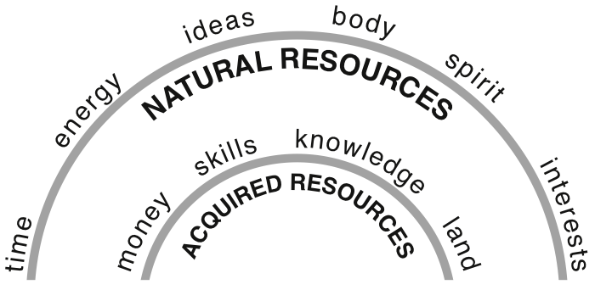
How do we build Relationships
Selection: What are our RESOURCES?
Notes:
Lets dive in to what resources that your actors have? Relationships, reputation, large following, etc…

Slide 34
The One-to-One Meeting
1. Selection
2. Purpose
“Hello, I am here to...”
Build a new relationship, deepen an existing relationship, or renew / redefine a relationship
Clarify your interest and purpose in meeting
Confirm the length of time to speak
Project enthusiasm & appreciation
Reference: ReThink Health & QIN-QIO National Coordinating Center, Leadership & Organizing in Action, 2015
Notes:
The next step is to state upfront your purpose for this meetings—even if it is something as basic as “I would like to learn more about your work and share what I am doing in the event we might be able to collaborate…” . We recommend confirming the length of time that you have set aside for the meeting so that this person knows that you are someone who values their time.
the next point goes is obvious, but it really helps to project your own enthusiasm for what you are doing and a sense of enthusiasm to be able to share it with others.
.

Slide 35
The One-to-One Meeting
1. Selection
2. Purpose
3. Exploration
“Tell me why…?” “I care because...”
Ask WHY questions to elicit & identify values
Explore shared interests
Listen for resources and skills
Tip: 80% listening / 20% sharing
Notes:
This next step constitutes the heart of the conversation. Most of the one-to-one is devoted to exploration, in which we ask probing questions – and listen deeply. It is during this step that we briefly share our story of self – where we came from, what drives us, what motivates us to participate in this work. But mostly we focus on eliciting the other person’s story. We ask questions like “Do you recall when you first decided to pursue a profession based on caring for others? What led you to that choice?” We look for the story behind the story by asking “why” questions. “You could be putting your time and energy into a million other things. Why this? Why you? Why now?”
Ask open-ended questions and listen and see where the conversation takes you.
And as we listen for values, we also listen for other person’s interests, skills and resources in the exploration phase. In listening for interests, we want to discover the types of things that the other person cares about. In listening for skills, we are identifying a person’s talents, experiences and expertise. This can range from clinical training to speaking another language to being a good communicator. And in listening for resources, we listen anything that can be used to achieve something else – from knowledge, networks and moral resources, to time, money, and organizational resources.

Slide 36
The One-to-One Meeting
1. Selection
2. Purpose
3. Exploration
4. [Mutual] Exchange
How can we be helpful to each other?
Strategize about the type of exchanges of skills and resources that are beneficial to achieve shared goals
Notes:
During the exploration phase, we take “mental notes” about what we are discovering and think strategically about possible exchanges of resources. In this next phase, we articulate what we may consider exchanging during the course of the meeting such as information, support, appreciation, challenge and insight. We may learn a great deal from our interaction with the other person and discover we have an opportunity to help one another around another shared purpose altogether. We identify these exchanges intentionally. You may signal the beginning of this by asking your conversation partner the question, “how can we be helpful to each other” or “what kind of work might we do together”? Invite your partner to creatively strategize with you about how might be able to help them before you dive into asking for what you need.

Slide 37
The One-to-One Meeting
1. Selection
2. Purpose
3. Exploration
4. Exchange
5. Commitment
What are our next steps?
Frame commitment as opportunity
Be specific about what we commit to (who will do what by when)
Notes:
Then you come to the final phase, which involves asking for a commitment—to a mutual exchange of resources. A common mistake is asking for commitment without laying a relational basis for it, which makes it simply a transaction. Another mistake is being unclear about the mutuality involved. What turns the exchange into a relationship is the commitment we make to each other to continue the relationship and commit our resources in service to a shared purpose. You might decide that is to invite someone to join you, or to meet with you again. Think about the commitment you are also making to support that person, as you exercise leadership to enable that person – and that person enables you – to achieve a shared purpose.
I want to emphasize an important part of asking for commitments. First, be sure to frame it as an opportunity, and second, be specific about what you are asking for. Sometimes we are afraid to ask people directly for a commitment, worried that we will burden them, or that they’ll say “no” and we’ll feel rejected. But by asking someone to participate, we are giving him/her an opportunity to act on her values. We are offering an opportunity to develop new skills and relationships around a shared vision for a better future. Frame the action within a story of now, articulate why it is important. Help others view it as an opportunity.
Second, be specific about what you’re asking for. We do not put in all this effort to build a relationship to then ask in generalities: “Do you want to be part of this?” We ask whether we can count on someone, and we use clear, concise language to describe what the next step is. We ask for a specific commitment that clarifies “who will do what by when.” We take out our calendars to schedule the date and time. We offer to help by sending a reminder email with the specifics, or to be in touch again to follow up. By doing this, we underscore that we have established a relationship on which future commitments can grow.

Slide 38
The One-to-One Meeting
1. Selection & attention
2. Purpose
3. Exploration
4. Exchange
NO Commitment
Reference: ReThink Health & QIN-QIO National Coordinating Center, Leadership & Organizing in Action, 2015
Notes:
So lets say that you get to the end of this conversation, you have completed all the phases, made the case for a mutual sharing of resources, passionately asked for a specific commitments and you get one of the following responses:
MAYBE, not sure, can I get back to you…..
NO and here is why….
What is the better answer? the “no” answer is the better answer because it gives you clear sense of where that person stands in your map. A maybe (for you and in this context) is a greater investment of your time. So, don’t fear asking for fear of getting a “no” answer. Not everyone will say yes but hopefully people will see that you are good listener with a deep integrity about the importance of your work.
It might also be the case that you discover that this is not the right time to ask for any kind of commitment. That’s okay too. You have learned something new about your context that will help you in the future. When I have found myself in these kinds of positions, I always thank my partner for their time and ask them who else I should be taking to. I also ask if they might offer an introduction.

Slide 39
The One-to-One Meeting: Recap
1. Selection & attention
2. Purpose
3. Exploration
4. Exchange
5. Commitment
Notes:
So let’s review the five steps:
First, get the person’s attention and set up intentional time to meet (ideally face to face); second, clearly establish your meeting purpose; third, elicit and explore values, interests, skills and resources; fourth, articulate the exchange you are making ; and fifth, seek a clear commitment based on mutual exchange.

Slide 40
Tips for Successful 1:1 Meetings
Reference: ReThink Health & QIN-QIO National Coordinating Center, Leadership & Organizing in Action, 2015
Notes:
here are a few tips to consider:
Be transparent about the amount of time you can spend,
Ask open-ended questions and remember that you should be listening 80% of the time and sharing your own story and experience, 20% of the time
Don’t skip exploration to “get to the point”—make it THE point that you seek to get to know this other person. And, try not to get side-tracked. This is why I find the 5 step framework so helpful. It keeps you focused and on track.
Finally, be clear about the ‘when and what’ of your next steps. Have fun and feel good about asking! People want to do work that really matters.

Slide 41
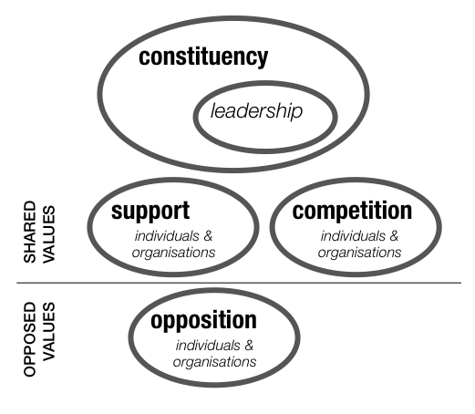
Building our Map of Actors
Who are the people I need to engage to do this work?
Notes:
This is where we start building our Map of Actors. We map actors so that we can co-produce our strategies with actors that recognize people as assets, build on their existing skills and resources, promote reciprocity, mutual respect and trust, break down professional siloes and other divisions, and build strong and supportive social networks.
Beginning with our constituents
We are extremely intentional in selecting who we meet with. From the Map of actors you will have a name for your supporters, constituents, competition and opposition. From this analysis, you would begin to see who might want to join you in your work.

Slide 42
Diagnostic Checklist for Leadership Teams

Slide 43
Review
A Compelling Purpose
Organizing Statement
The Stories of Self, Us, Now – Call to Action
The Right People
Mapping Actors
The One-to-One
Enabling Structure
The Snowflake
Meeting Structures & Tools

Slide 44
Great News!
HQI has received 5 more years of CMS funding to be Virginia’s QIN-QIO
Our support for the 10 existing care transitions coalitions will continue
We need your help to establish additional coalitions in southwest and northwest VA
We are working with other community partners on population health topics that complement admission/readmission reduction
Notes:
I have some exciting news to share with you (as we begin, or as we wrap up)
[Paraphrase slide]

Slide 45
Community Health Priorities
Care Transitions
Patient
Safety
Chronic Disease Self-Management
Opioids & Behavioral Health
Notes:
CMS has focused improvement on national health care priorities.
Other federal health agencies share these priorities. CMS designed HQIN’s work to strengthen, complement or expand many of the initiatives being conducted by agencies like the Centers for Disease Control and Prevention.
To avoid duplication, the work that HQIN does as a QIN-QIO also coordinates with other CMS quality programs like the Hospital Improvement Innovation Networks. Many of the quality measures we use can be reported by clinicians for credit in MIPS, Medicare’s value-based payment program.

Slide 46
Community Health Goals
Care Transitions
Reduce hospital admissions and readmissions
Reduce ED visits and admissions by super-utilizers
Reduce potentially avoidable admissions, readmissions and super-utilization
Notes:
In addition to continued progress on reducing avoidable admissions and readmissions, the work on improving the quality of care transitions includes a few new twists: addressing emergency department utilization and super-utilization

Slide 47
Community Health Goals
 | Patient Safety (ADEs) |  | Chronic Disease Self-Management |  | Opioids & Behavioral Health
Medication reconciliation programs as part of transition services |  | CKD screening at community meal sites |  | Promoting safe medication use such as local prescription drug take-back days
Notes:
There are also ways for AAAs and other community-based organizations to support improvement on the other health priorities. Here are some that we can imagine; I hope you will think of others and what best addresses your capabilities the needs of local seniors.

Slide 48
Learn more and join us now
CMS awarded HQI the states of Kansas, Missouri, South Carolina and Virginia
We are branding QI work across these states as the Health Quality Innovation Network (HQIN)
Visit us online at www.hqin.org to learn more and sign up!
Notes:
This is breaking news, so I hope you’ll learn more and pass the word!

Slide 49
FOR MORE INFORMATION
Call 877-731-4746 or visit www.hqin.org
Carla K. Thomas, MS, CTRS, CPHQ
Director
cthomas@hqi.solutions
804-289-5318

